Slide 1

تحليل البيانات باستخدام الاكسل – اليوم الثالث
إعداد و تقديم:
عبدالله العمير

Slide 2

Introduction to Macros and VBA in Excel
Macros are automated sequences of actions that you can record and replay in Excel.
VBA stands for Visual Basic for Applications, a programming language used to write macros.

Slide 3


What are Macros and VBA?
Macros
VBA
Macros are a set of recorded actions in Excel that automate repetitive tasks. These can be simple tasks like formatting cells or more complex tasks like generating reports.
Visual Basic for Applications (VBA) is a programming language used to create and customize macros. It allows you to write code that controls Excel and perform various actions.

Slide 4




Benefits of using Macros and VBA
Increased Efficiency
Enhanced Productivity
Improved Data Analysis
Greater Accuracy
Macros automate repetitive tasks, saving you time and effort. You can complete tasks faster and with fewer errors.
Macros reduce the risk of human error by automating repetitive tasks, leading to more reliable and accurate results.
Macros allow you to perform complex calculations and data manipulations easily, boosting your productivity and accuracy.
Macros enable sophisticated data analysis by automating complex calculations and visualizations, leading to better insights.

Slide 5

Getting started with Macros
1
Enable the Developer Tab
To access macro-related features, ensure the Developer tab is enabled in Excel's ribbon.
2
Record Your First Macro
Start by recording a simple macro to understand its basic functionality and the process of capturing actions.
3
Explore the VBA Editor
Open the VBA editor to examine the generated code and gain insights into the underlying structure and syntax of macros.

Slide 6




Recording a Macro
Macros are essentially recorded actions that Excel can execute automatically. Recording a macro lets you capture a series of actions in a sequence and then replay them whenever you need.
Open the Developer tab
1
Enable the Developer tab if it's not visible.
Start recording
2
Click the "Record Macro" button and give your macro a name.
Perform actions
3
Carry out the tasks you want to automate.
Stop recording
4
Click the "Stop Recording" button.
The recorded actions are translated into VBA code, which you can then edit and modify to customize the macro's behavior.

Slide 7




Editing a Macro
Open the VBA Editor
Access the VBA Editor by pressing Alt + F11 or by going to Developer > Visual Basic.
Locate the Macro
Find the macro you want to edit in the Project Explorer window on the left.
Modify the Code
Make the necessary changes to the macro code in the code editor.
Save and Test
Save your changes and test the macro to ensure it functions as intended.

Slide 8
Running a Macro
Enable Macros
1
Ensure macro security settings allow macros to run.
Select Macro
2
Access the Developer tab and choose the desired macro.
Run Macro
3
Click the "Run" button or use the keyboard shortcut.
To execute a macro, you must first enable macros in Excel's security settings. Next, locate the macro you want to run. You can do this by going to the Developer tab, then selecting the macro from the "Macros" dropdown menu. Once selected, click the "Run" button or use the assigned keyboard shortcut. The macro will then execute, performing the pre-programmed actions.

Slide 9



Assigning a Macro to a Button or Keyboard Shortcut
Create a Button
Insert a button onto your worksheet by going to the Developer tab and clicking "Insert." Choose the button shape and position it on your worksheet.
Assign the Macro
Right-click the button and select "Assign Macro." From the list, choose the macro you want to assign to the button.
Keyboard Shortcut
In the "Developer" tab, click "Macro." Select the macro and click "Options." Enter a keyboard shortcut and click "OK." You've now assigned a keyboard shortcut to your macro.

Slide 10
Understanding the VBA Editor
The VBA Editor
Key Features
The VBA Editor is the heart of macro development in Excel. It's a dedicated environment for writing and managing your VBA code.
The VBA Editor boasts various features that make it a robust platform for macro development.
Code Editor with syntax highlighting and intellisense
This powerful tool provides a comprehensive interface for creating, debugging, and running VBA projects.
Project Explorer for organizing your VBA modules and projects
Immediate Window for testing code snippets
Debugging tools for tracing code execution and identifying errors

Slide 11
VBA Basics: Variables, Data Types, and Operators
1
1. Variables
2
2. Data Types
Variables are like containers that store data. You can give them names and assign values to them.
Data types specify the kind of data a variable can hold, such as numbers, text, or dates.
3
3. Operators
4
4. Scope
Operators perform actions on variables, like addition, subtraction, or comparison.
The scope of a variable determines where in your code it can be accessed.

Slide 12

VBA Procedures: Subroutines and Functions
Subroutines
Subroutines are blocks of code that perform a specific task. They are called by name and can be used to organize your VBA code.
Functions
Functions are similar to subroutines, but they return a value. They are often used to perform calculations or to retrieve data.
Procedure Syntax
Both subroutines and functions use a specific syntax to define their parameters, arguments, and return values.

Slide 13
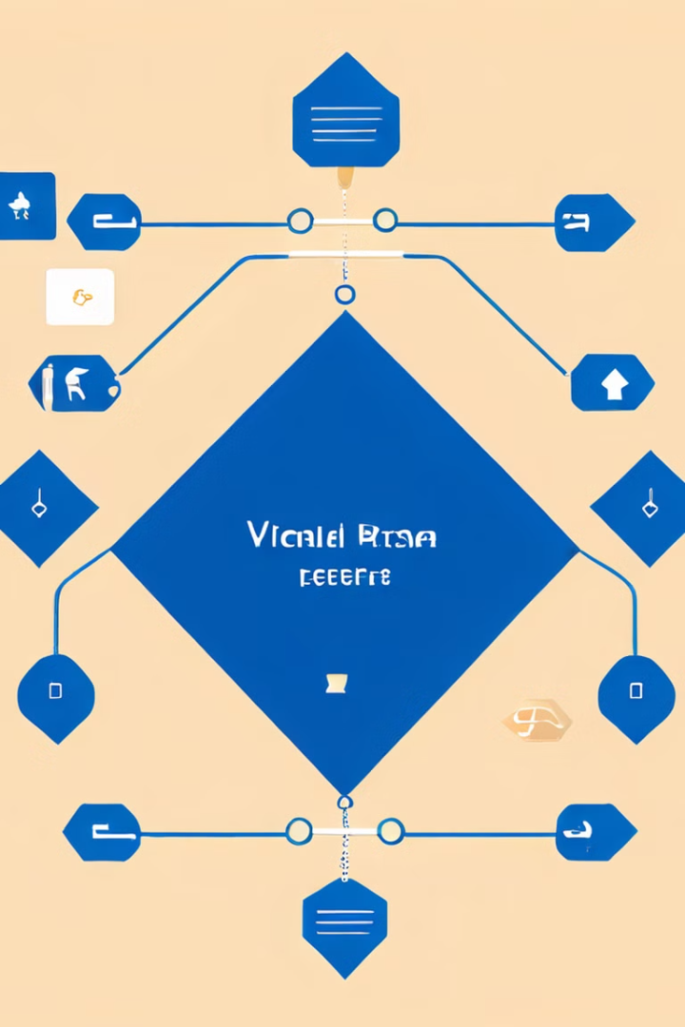
Conditional Statements in VBA
1
1. If Statements
If statements execute code blocks depending on whether a condition is true or false.
2
2. ElseIf Statements
ElseIf statements provide additional conditions to evaluate when the initial If statement condition is false.
3
3. Select Case Statements
Select Case statements provide an alternative to nested If statements for evaluating multiple conditions.
4
4. Logical Operators
Logical operators like AND, OR, and NOT can be used to combine multiple conditions within conditional statements.

Slide 14
Loops in VBA
Types of Loops
Loop Control Statements
VBA offers three main loop types: For...Next, While...Wend, and Do...Loop.
You can control the flow of a loop using Exit For, Exit While, and Exit Do statements.
For...Next loop iterates a specific number of times.
These statements allow you to break out of the loop before it completes its iterations.
While...Wend loop continues until a condition becomes false.
Do...Loop loop executes at least once and then continues until a condition becomes true or false.

Slide 15



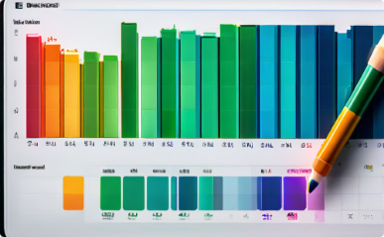
Working with Ranges and Cells in VBA
Selecting Cells
Accessing Cell Values
Working with Formulas
Creating Dynamic Ranges
VBA provides methods for selecting individual cells, ranges of cells, and entire rows and columns.
You can retrieve and manipulate data within cells using VBA, allowing you to perform calculations, update values, and format data.
VBA enables you to create and manipulate formulas within cells, automating complex calculations and data analysis.
Define dynamic ranges that adjust based on data changes, ensuring accurate calculations and data manipulation.

Slide 16



Manipulating Worksheets and Workbooks in VBA
Workbooks
Worksheets
Cells and Ranges
VBA allows you to interact with entire Excel workbooks. You can open, close, save, and copy workbooks using VBA commands.
VBA provides extensive control over individual worksheets within a workbook. You can add, delete, copy, and move worksheets using VBA.
VBA allows you to access and manipulate individual cells and ranges of cells within worksheets.

Slide 17

Debugging VBA Code
Stepping through code
Breakpoints
Use the F8 key to step through your VBA code line by line. This allows you to see the execution flow and identify any errors.
Set breakpoints at specific lines in your code to pause execution and inspect variables or expressions.
Immediate Window
Watch Window
The Immediate Window in the VBA Editor lets you execute VBA commands and inspect values during debugging.
Add variables or expressions to the Watch Window to monitor their values as you step through your code.

Slide 18



Error Handling in VBA
Anticipating Problems
Preventing Crashes
Improving Code Robustness
VBA code can encounter errors, such as invalid data, missing files, or incorrect calculations.
Error handling helps to gracefully manage unexpected situations, preventing your code from crashing.
By trapping and handling errors, your VBA code becomes more reliable and user-friendly.

Slide 19
User Forms in VBA
Creating User Forms
Adding Controls
User Input and Data Validation
Customizing the User Experience
Controls allow users to input data, make selections, and trigger actions. You can customize the appearance and behavior of each control. You can also write code to respond to user events, like button clicks or changes in text boxes.
User forms provide a visual interface for interacting with your macros. You can create custom forms using the VBA editor. The form designer provides tools for adding controls such as buttons, text boxes, and list boxes.
User forms provide a convenient way to gather data from users. You can use VBA code to validate user input and ensure data quality. This helps to prevent errors and ensure that your macros work as expected.
You can customize the appearance of your user forms to match your application's theme. You can change the font, color, size, and positioning of form elements. This can improve the user experience and make your macros more user-friendly.

Slide 20



Interacting with Other Office Applications
Data Exchange
Cross-Application Automation
Mobile Integration
Macros can automate data transfer between Excel and other Office apps like Word, PowerPoint, and Access.
Macros can interact with Excel Mobile for tasks like accessing data or updating reports on the go.
Automate tasks across multiple Office applications, like generating reports in Word from Excel data.

Slide 21
Automating Repetitive Tasks with Macros
Time Saver
Increased Accuracy
Macros can help you automate repetitive tasks in Excel, saving you valuable time and effort. You can eliminate manual steps and focus on more strategic activities.
By automating tasks, you reduce the risk of human errors, ensuring consistent and accurate results. This is especially beneficial for complex calculations or data entry.
Improved Efficiency
Enhanced Consistency
Macros can streamline your workflow by automating repetitive processes, leading to increased efficiency and productivity. You can accomplish more in less time.
Macros ensure that tasks are performed consistently every time, eliminating variations caused by manual intervention. This is crucial for maintaining data integrity.

Slide 22
Optimizing Macro Performance
Efficient Code
Data Handling
Write concise code that avoids unnecessary loops or calculations. Use built-in functions and methods whenever possible.
Optimize data handling. Avoid unnecessary copying or resizing of large datasets. Use arrays and collections for efficient data manipulation.
User Interface
Debugging Tools
Limit user interaction during macro execution to avoid slowing it down. Use screen updates selectively.
Utilize VBA's debugging tools to identify and fix performance bottlenecks. Use the Step Into and Step Over options to analyze code execution.

Slide 23




Security Considerations for Macros
Macro Security
Malicious Macros
Trustworthy Sources
Macro Auditing
Macros can pose a security risk if they are not properly secured.
Malicious macros can be used to steal data, install malware, or disrupt your computer's operations.
Regularly audit your macros to ensure they are secure and functioning as expected.
Only download and run macros from trusted sources to minimize security risks.

Slide 24
Best Practices for Macro Development
1
1. Commenting
2
2. Error Handling
Add comments to explain what your code does. This makes it easier to understand and maintain your macros.
Implement error handling to gracefully handle unexpected issues, preventing macros from crashing.
3
3. Code Organization
4
4. Optimization
Structure your code logically with clear sections, functions, and subroutines for better readability.
Optimize your macros for speed and efficiency by using efficient VBA techniques and avoiding unnecessary calculations.

Slide 25
Sharing and Distributing Macros
Sharing with Colleagues
Distributing Publicly
You can share macros with colleagues in your organization by exporting them as add-ins, which can be installed on other computers.
If you want to share your macros publicly, you can distribute them online.
You can use platforms like GitHub to host your VBA code, allowing others to download and use your macros.
Save the macro as an .xlam file, which is an Excel add-in, and then distribute it to other users.

Slide 26



Integrating Macros with Excel Add-ins
Extending Functionality
Seamless Integration
Expanding Possibilities
Add-ins can extend Excel's capabilities by providing new features and tools, such as data analysis, visualization, and automation. Macros can be used to enhance and customize the functionality of these add-ins.
Macros can interact with add-in objects and functions, enabling you to automate tasks that involve add-in features. This provides a cohesive and efficient workflow.
By combining the power of macros with add-ins, you can unlock new possibilities in automating complex tasks, integrating data from various sources, and extending Excel's capabilities.

Slide 27

Macros and VBA in Excel 365
Enhanced Functionality
Excel 365 offers new features and improvements for macros and VBA.
Improved Performance
VBA code runs faster and more efficiently in Excel 365.
Integration with Cloud Services
Macros can access and manipulate data from cloud storage services like OneDrive.
Modernized Interface
The VBA editor in Excel 365 has a more modern and user-friendly interface.

Slide 28
Troubleshooting Common Macro Issues
1
1. Runtime Errors
2
2. Debugging Tools
These errors occur during macro execution. Identify the error, review code logic, and check data validity.
Use the VBA debugger to step through code line by line, set breakpoints, and inspect variables.
3
3. Unexpected Results
4
4. Macro Security
Test macros thoroughly with different data sets. Review code logic and ensure intended actions are performed.
Enable macro security settings to prevent malicious code execution. Update security software and enable digital signatures.

Slide 29
Resources for Learning More about Macros and VBA
Online Courses
Excel Documentation
Numerous websites and platforms offer comprehensive VBA courses, covering everything from the basics to advanced concepts.
Microsoft provides extensive documentation and tutorials on VBA, covering functions, objects, and best practices.
Community Forums
Books and eBooks
Online forums dedicated to Excel and VBA offer a platform for asking questions, seeking help, and sharing knowledge.
Many books and eBooks provide in-depth explanations of VBA concepts, along with practical examples and case studies.

Slide 30
Conclusion and Next Steps
By learning Macros and VBA, you can automate tasks, enhance efficiency, and create powerful custom solutions for your Excel work.
Continue exploring the world of Excel automation by experimenting with different macro techniques, exploring advanced VBA concepts, and utilizing online resources to further your expertise.

